Slide 1
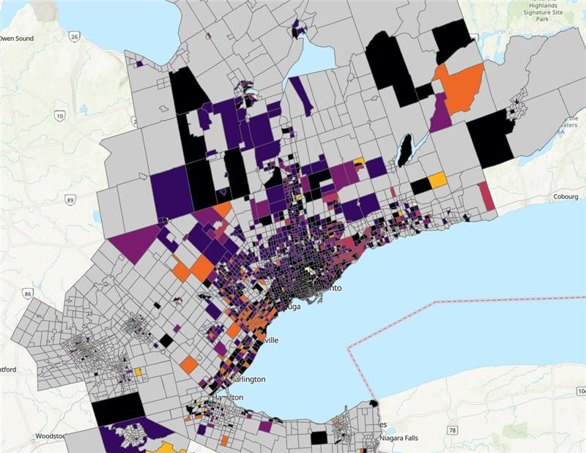
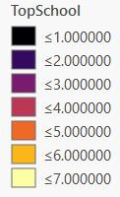
SMTO 2015 – Most Popular Campus
SG
YK
RY
SC
MI
OC
YG

Slide 2
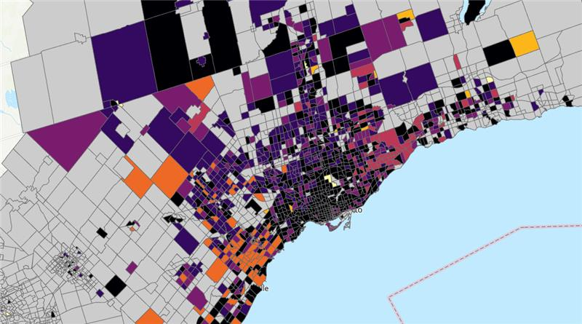
SMTO 2015 – Most Popular Campus
SG
YK
RY
SC
MI
OC
YG

Slide 3
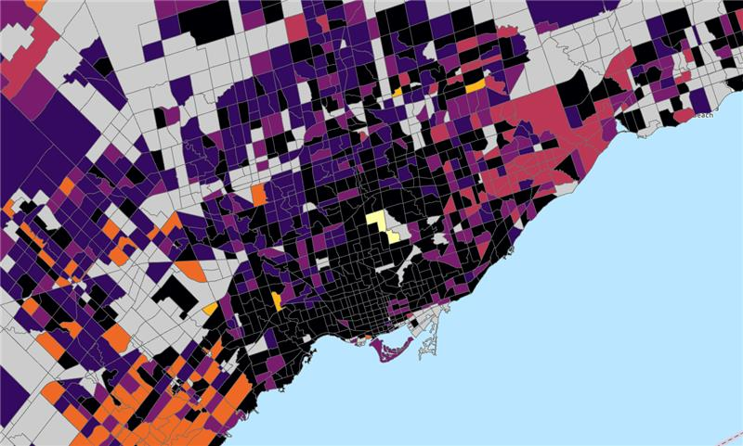
SMTO 2015 – Most Popular Campus
SG
YK
RY
SC
MI
OC
YG

Slide 4
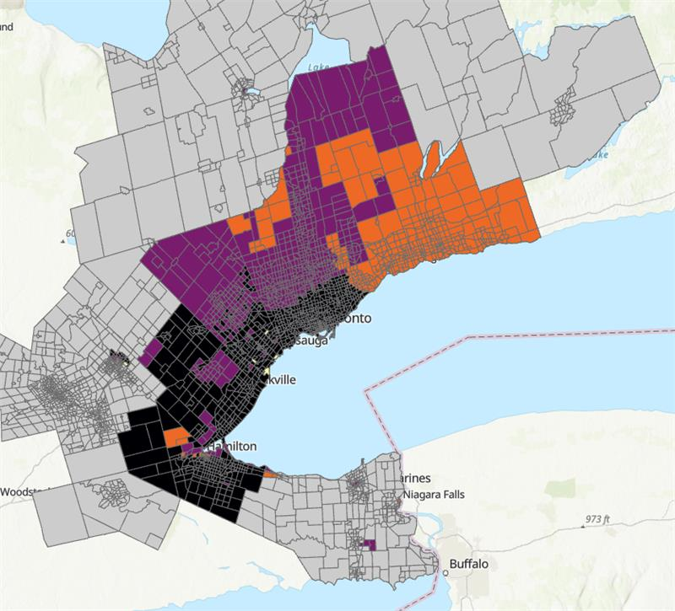
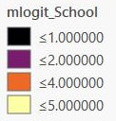
Logit Gravity Model – Most Likely Campus
SG
YK
SC
MI

Slide 5
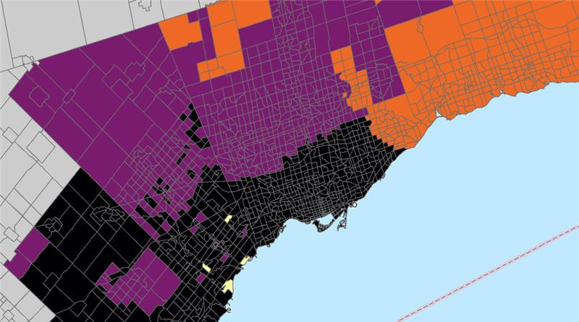
Logit Gravity Model – Most Likely Campus
SG
YK
SC
MI

Slide 6
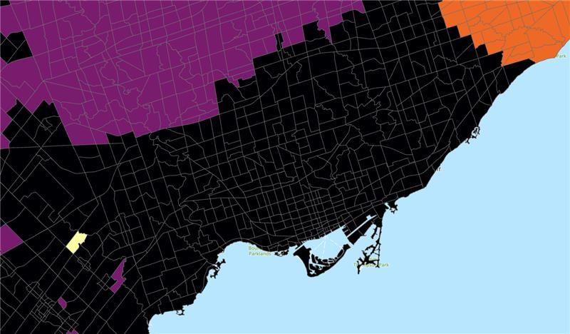
Logit Gravity Model – Most Likely Campus
SG
YK
SC
MI

Slide 7
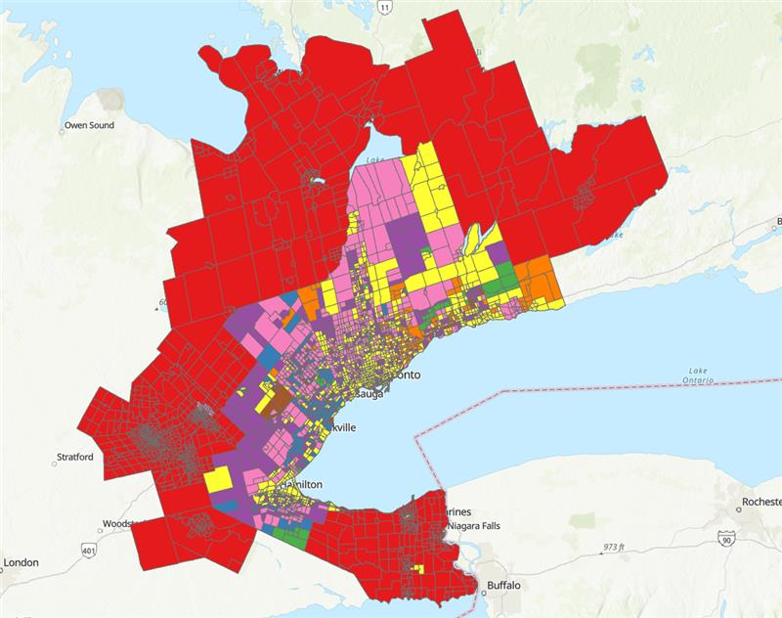
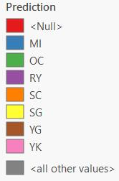
Random Forest Model – Most Likely Campus (Home Zone)

Slide 8
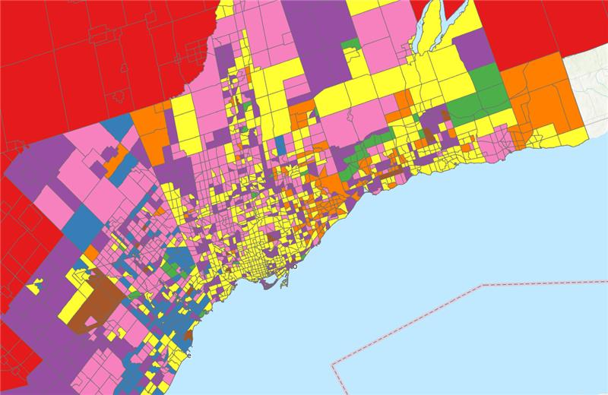
Random Forest Model – Most Likely Campus (HZ)

Slide 9
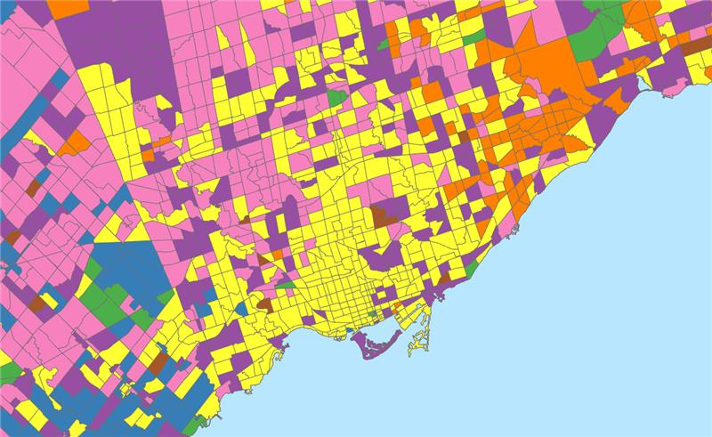
Random Forest Model – Most Likely Campus (HZ)

Slide 10
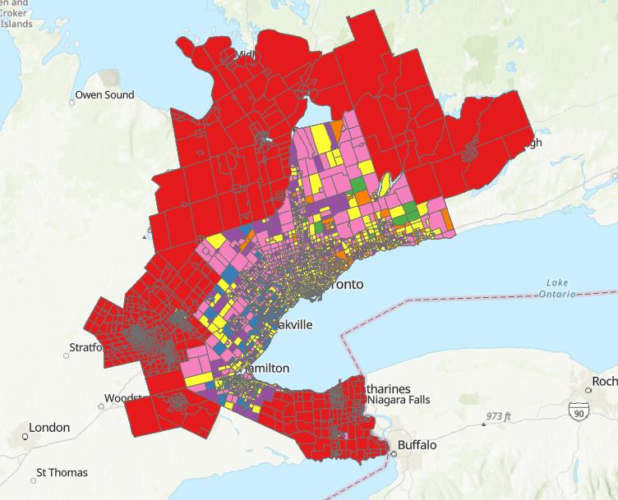
Random Forest Model – Most Likely Campus (Distances)

Slide 11
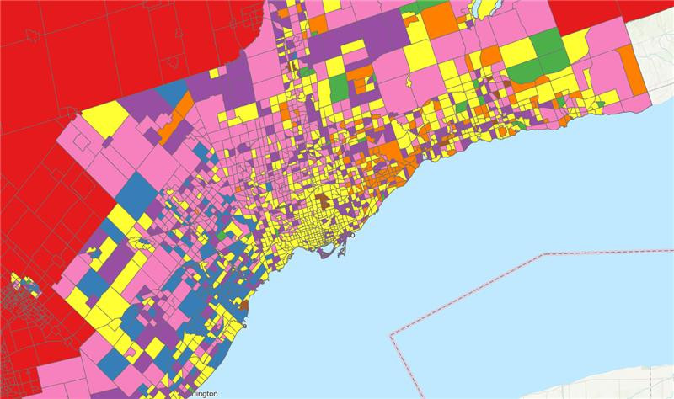
Random Forest Model – Most Likely Campus (Dists)

Slide 12
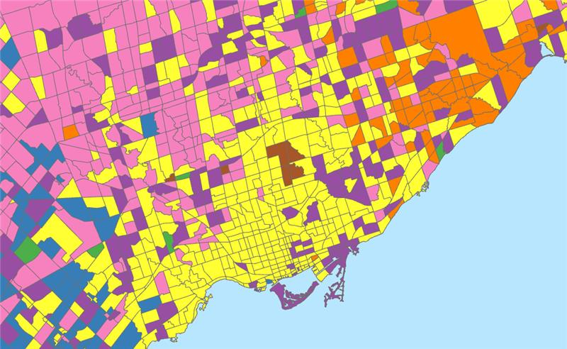
Random Forest Model – Most Likely Campus (Dists)

